Slide 1
Real Estate Market Analysis
Insights from Power BI Dashboard

Slide 2
Purpose of the Report
The primary purpose of this report is to analyze the Singapore real estate market, with a specific focus on resale prices. By leveraging the insights from the Power BI dashboard, we aim to:
Identify trends and patterns: Analyze historical data to identify trends in resale prices over time.
Understand price variations: Explore how factors like location, flat type, and floor area influence resale prices.
Identify investment opportunities: Identify areas with high potential for real estate investment and appreciation.
Inform decision-making: Provide data-driven insights to inform real estate investment decisions, property valuation, and policy-making.
By understanding the dynamics of the Singapore real estate market, we can make informed decisions and capitalize on emerging opportunities.

Slide 3
Data Information
• The data is from a real estate company specializing in housing and property sales.
• This dataset contains all the required detail such as block, flat model, flat area, resale price etc.
• These columns provide essential information about the properties in the dataset, enabling analysis
and insights into the resale market within the specified area.
• All the information about the features is present in Data_Dictionary.pdf

Slide 4
Filters in the Real Estate Dashboard
The dashboard provides several filters to refine the analysis and gain deeper insights into the Singapore real estate market.
Key Filters and Their Impact:
Flat Model:
All: Shows data for all flat models.
Specific Models: Allows you to focus on particular flat types (e.g., 1-room, 2-room, etc.) to analyze their price trends and performance.
Town:
All: Shows data for all towns in Singapore.
Specific Towns: Allows you to analyze specific regions to understand local market dynamics.
Flat Type:
All: Shows data for all flat types.
Specific Types: Allows you to focus on a particular flat type (e.g., 3-room, executive) to analyze its price trends.
Price Range:
All: Shows data for all price ranges.
Specific Ranges: Allows you to filter data based on price ranges to identify affordable or premium properties.
How to Use the Filters:
Select a Filter: Click on the desired filter and choose the appropriate option from the dropdown menu.
Combine Filters: You can combine multiple filters to create more specific analyses. For example, you can filter by town and flat type to analyze the performance of a particular type of flat in a specific location.
Explore Different Scenarios: Experiment with different filter combinations to uncover valuable insights and answer specific questions.
Benefits of Using Filters:
Customized Analysis: Tailor the analysis to your specific needs and interests.
In-Depth Insights: Focus on specific segments of the market to gain deeper insights.
Comparative Analysis: Compare the performance of different flat types, locations, or price ranges.
Identify Trends and Patterns: Discover emerging trends and patterns by filtering data based on various criteria.
By effectively using these filters, you can unlock valuable insights and make informed decisions about real estate investments in Singapore.

Slide 5
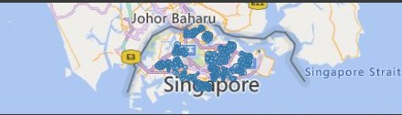
Resale Price Distribution by Location Map
The map visualization provides a spatial representation of resale prices across different locations in Singapore. Here are some key insights:
Regional Price Variations:
The map clearly shows that different regions in Singapore have varying levels of property values.
Certain areas, particularly those in the central and eastern regions, tend to have higher resale prices.
Areas in the outskirts or northern regions generally have lower resale prices.
Spatial Clustering:
The map reveals clusters of high-priced and low-priced areas.
This clustering might be influenced by factors such as proximity to amenities, transportation hubs, and central business districts.
Identifying Hotspots:
By analyzing the map, you can identify specific neighborhoods or districts with high potential for real estate investment.
These areas often have strong demand, good infrastructure, and future development prospects.

Slide 6
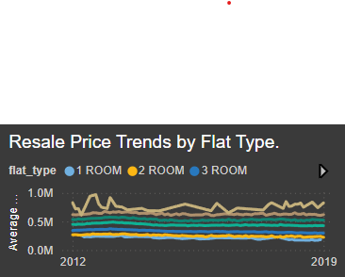
Resale Price Trends by Flat Type
The line chart titled "Resale Price Trends by Flat Type" provides valuable insights into how resale prices have changed over time for different flat types in Singapore.
General Upward Trend: Most flat types exhibit an overall upward trend in resale prices over the years. This suggests a strong and growing real estate market.
Room Type Impact: The number of rooms significantly influences the resale price. Larger flats (e.g., 5-room, executive) generally command higher prices.
Market Fluctuations: The chart reveals fluctuations in resale prices, which may be attributed to various factors like economic conditions, interest rates, and government policies.
Flat Type-Specific Trends: Some flat types, such as executive flats, might show steeper price increases compared to others.

Slide 7
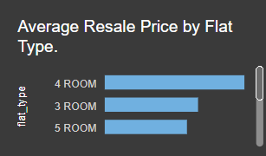
Resale Price by Flat Type
The bar chart titled "Average Resale Price by Flat Type" provides a visual comparison of the average resale prices for different flat types in Singapore. Each bar represents a specific flat type, and the height of the bar indicates the average resale price for that type.
Key Insights:
Flat Type Variation: The chart clearly shows that different flat types have varying average resale prices. This is likely influenced by factors such as size, location, and amenities.
Price Hierarchy: The flat types are generally arranged in ascending order of average price, with smaller flat types (e.g., 1-room, 2-room) having lower average prices and larger flat types (e.g., 5-room, executive) having higher average prices.
Price Differences: The height differences between the bars highlight the price differentials between different flat types. For instance, the average price of a 5-room flat is significantly higher than that of a 1-room flat.

Slide 8
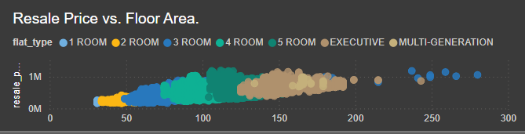
Resale Price vs. Floor Area" Scatter Plot
The scatter plot titled "Resale Price vs. Floor Area" provides a visual representation of the relationship between the resale price of a property and its floor area. Each data point represents a specific property, with its position on the plot determined by its floor area (x-axis) and resale price (y-axis).
Key Insights:
Positive Correlation: As the floor area increases, the resale price generally tends to increase as well. This suggests a positive correlation between the two variables.
Price Variation Within Floor Area: Even within a specific floor area range, there's significant variation in resale prices. This indicates that other factors, such as location, age, and condition of the property, also influence the price.
Outliers: There are some data points that deviate from the general trend, representing properties with either exceptionally high or low prices compared to their floor area. These outliers could be due to factors like unique features, prime locations, or specific market conditions.

Slide 9
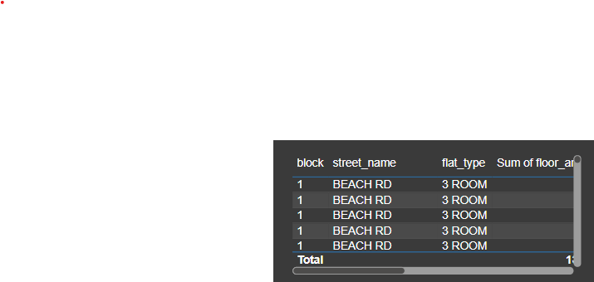
Table
The table provides a detailed breakdown of resale prices for different flat types across various locations in Singapore.
Flat Types: The table includes data for 1-room, 2-room, 3-room, 4-room, 5-room, executive, and multi-generation flats.
Price Range: The resale prices vary significantly across flat types, with larger flats generally commanding higher prices.
Location Impact: The specific location (block, street name, and town) also influences the resale price.
Insights:
Price-Area Relationship: There is a clear positive correlation between floor area and resale price. Larger flats tend to have higher resale values.
Location Premium: Flats located in prime areas or desirable neighborhoods often command higher prices, even for similar floor areas.
Flat Type Value: Different flat types have varying price points, with executive and multi-generation flats typically being more expensive.

Slide 10
Overview of Key Findings
Based on the Real Estate Dashboard, we can identify several key findings:
Resale Price Distribution by Location:
Regional Variations: Resale prices vary significantly across different regions in Singapore.
Prime Districts: Certain districts, such as the Central Region, command higher resale prices.
Affordable Housing: The Outer Regions offer more affordable housing options.
Resale Price Trends by Flat Type:
Price Appreciation: Most flat types have experienced upward price trends over time.
Premium Flat Types: Larger flat types, such as 5-room and Executive flats, tend to have higher resale prices.
Market Dynamics: The market dynamics for different flat types may vary due to factors like demand, supply, and government policies.
Average Resale Price by Flat Type:
Flat Type Influence: The average resale price varies significantly across different flat types.
Premium Flat Types: Executive and 5-room flats command higher average prices.
Affordability: Smaller flat types, like 1-room and 2-room flats, are generally more affordable.
Resale Price vs. Floor Area:
Positive Correlation: There is a positive correlation between resale price and floor area. Larger flats tend to have higher prices.
Outliers: Some flats may deviate from the general trend due to factors like location, condition, and additional features.

Slide 11
Recommendations
Targeted Marketing:
Implement targeted marketing strategies for specific locations and property types to attract potential buyers.
Utilize digital marketing channels to reach a wider audience.
Data-Driven Decision Making:
Continuously monitor market trends and adjust strategies accordingly.
Use data analytics to identify emerging trends and opportunities.
Leverage predictive analytics to forecast future market behavior.
Strategic Partnerships:
Collaborate with real estate agents, property developers, and financial institutions to expand market reach.
Explore joint ventures and partnerships to leverage synergies.
Customer-Centric Approach:
Prioritize customer needs and preferences.
Offer personalized services and after-sales support.
Risk Management:
Conduct thorough due diligence on properties to mitigate risks.
Stay updated on government policies and regulations that may impact the real estate market.
By effectively utilizing the insights from the Power BI dashboard and implementing these recommendations, real estate professionals can make informed decisions, optimize their strategies, and achieve sustainable growth.

Slide 12
THANK YOU

